Slide 1
武汉大学
数字人文研究介绍
数字人文研究中心
王晓光教授团队
Discussion for DH-Reasearch
Center for Digital Humanities, Wuhan University, Team of Prof. Xiaoguang Wang

Slide 2
CONTENT
数据集介绍
Dataset Acquisition
01
数据处理
Data Process
02
数据管理
Data Management
03
数据集成展示
Data Integrated Presentation
04
02

Slide 3
01
数据集介绍
PART ONE
Dataset Acquisition

Slide 4
1.数据集介绍—图像 Dataset Acquisition—Image
大都会博物馆 Metropolitan Museum of Art
413628份文物的元数据，含有273967张图像，图像大小均在800KB以内，分辨率为72、150、180、300、600dpi
Metadata for 413,628 cultural relics which include 273,967 images.
Size per image: under 800kb. Resolution: 72; 150; 180; 300; 600dpi.
可移动文物网 Website of Chinese Removable relic
216251份文物的元数据，含有520618张图像（含3981张佛教图像），图像大小均在100KB以内，分辨率为96、200dpi
Metadata for 216,251 cultural relics which include 520,618 images (including 3981 of Buddhism). Size per image: under 100kb. Resolution: 96; 200dpi.
寺庙造像数据库 Database of Chinese Temples' statues
4723份造像的元数据，含有1330个分类下的4719张图像，图像均在2MB以内，分辨率为96dpi
Metadata for 4,723 statues which include 4,719 images under 1,330 categories.
Size per image: under 2MB. Resolution: 96dpi.
敦煌图册扫描件 Scanning of Dunhuang Picture Album
2877张敦煌壁画，均含有元数据，图像均在10MB以内，分辨率为96、300dpi
Metadata for 2,877 images of Dunhuang murals.
Size per image: under 10MB. Resolution: 96; 300dpi.
04

Slide 5
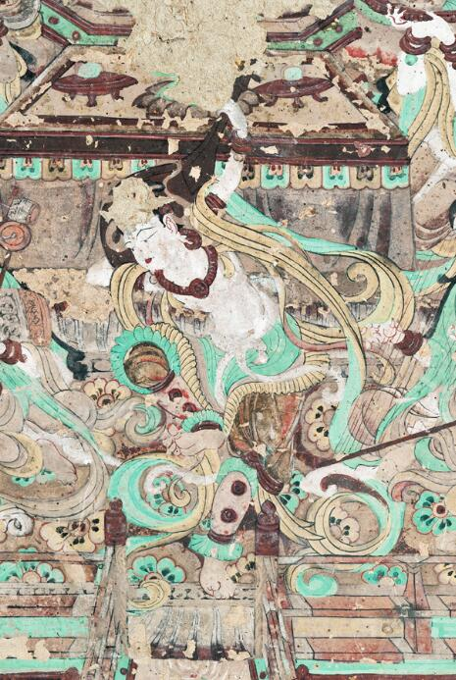
1.数据集介绍—文本 Dataset Acquisition—Text
敦煌石窟内容总录，包含全部492个洞窟的详细内容介绍。已完成结构化处理，转化为了知识图谱。
The Dunhuang caves content list, including detailed information for all 492 caves. All have been structured and turned into knowledge graph.
敦煌大辞典，包含敦煌遗书及学术研究中60余类6925条词条，共164万字，并以此构造了敦煌词表。
Dunhuang Dictionary, including 6,925 entries of Dunhuang manuscripts and academic studies under 60+ categories.
敦煌研究文献，7929本电子书，557GB。5083篇论文，已文本化处理了784篇。
Academic literatures of Dunhuang research. 7,929 e-books, 557GB. 5,083 papers, 784 of them have been textualized.
05

Slide 6
02
数据处理
PART TWO
Data Process

Slide 7
2.数据处理—壁画元数据标准 Data Process—Metadata Standards
During the process of collecting data，we mainly refer to Specification for Mural Metadata by Peking university (a national standard).
Peking university Mural Metadata Specification is primarily based on international cultural relic metadata standard (such as CDWA and Getty)， and is combined with cultural relics standard issued by China cultural relics bureau. So it's not only authoritative, but adjusts to Chinese relics better.
In this specification, the title (former title, other title), current location(geographic location, longitude and latitude), creation (creator, creation date, creation location), measurement (size, volumes) and other elements of the mural are defined.
在集成数据的过程中，主要参考了北大版的壁画元数据规范(国标)。
该元数据规范参考了CDWA、Getty等国际文物元数据规范，还结合了中国文物局颁布的文物标准，因此既具有权威性，也同中国的文物有很好的适用性。
规范中对壁画的名称(原名、其他名称)、位置(地理名称、坐标)、创建(创建者、创建年代、创建地点)、测量(尺寸、面积)等等元素进行了定义。
07

Slide 8
2.数据处理—图像 Data Process—Image
开发了图像数字资产管理系统(IDAMS)，进行了图像标注
Developed the Image Data Assets Management System(IDAMS) to annotate images
佛脸标注 Faces of buddha Annotation
24752张佛脸 24,752 faces of buddha
可移动文物网
Website of Chinese Removable relic
标注了 3118个佛脸，
3,118 faces of buddha were annotated
寺庙造像数据库
Database of Chinese Temples' statues
标注了10109个佛脸，
10,109 faces of buddha were annotated
敦煌图像扫描件
Scanning of Dunhuang Picture Album
标注了11525个佛脸，
11,525 faces of buddha were annotated
61窟主室西壁五台山图标注
标注了185个区域，包括寺庙、佛塔、灵异瑞现、人物、地点5类，搜集了相关元数据及资源。
Mural Annotation of Mountain Wutai
185 areas, categorized into temples, pagodas, auspicious signs, characters and locations, are annotated and we also collected relevant metadata and resources.
08

Slide 9
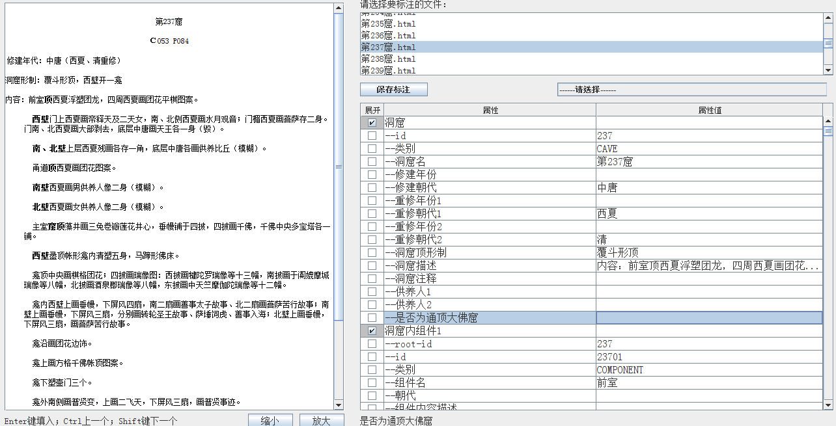
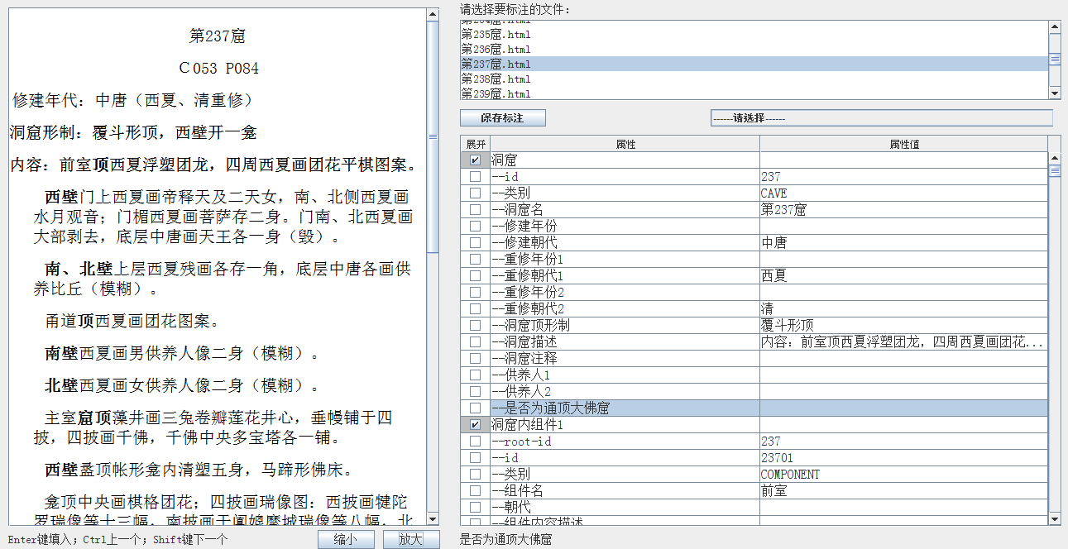
2.数据处理—文本 Data Process—Text
开发了文本细粒度语义标注工具，对敦煌石窟内容总录进行了标注，完成了结构化处理，存入了Neo4j。
We developed the Text Deep Semantic Annotation Tool to analyze the Dunhuang caves content list and construct the Knowledge Graph for all 492 caves.
Then, we stored these datas into the Graph Database-Neo4j after data-structuring.
09

Slide 10
03
数据管理
PART THREE
Data Management

Slide 11
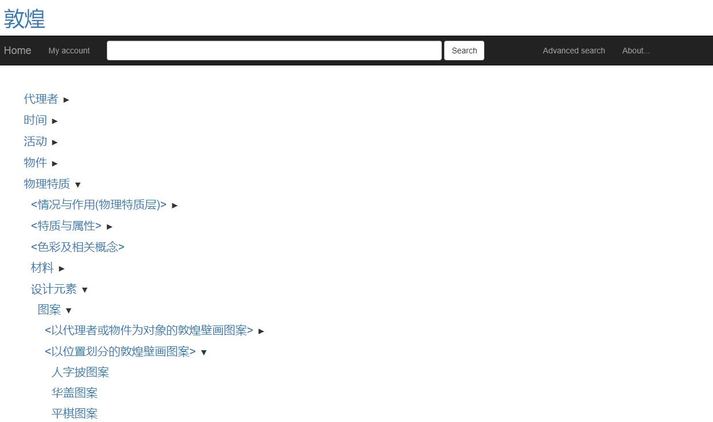
3.数据管理—词表 Data Management—Controlled Vocabularies List
部署了词表管理系统 Deployed the Controlled Vocabulary Management System
通过HMM模型，对敦煌学大辞典进行了新词发现，并利用CRF模型进行了命名实体识别，进而完成了敦煌词表构建。
Using the HMM model for new word detection in Dunhuang dictionary and using the CRF model for Named Entity Recognition to construct Dunhuang controlled vocabularies list.
词表管理系统 Controlled Vocabulary Management System
11

Slide 12
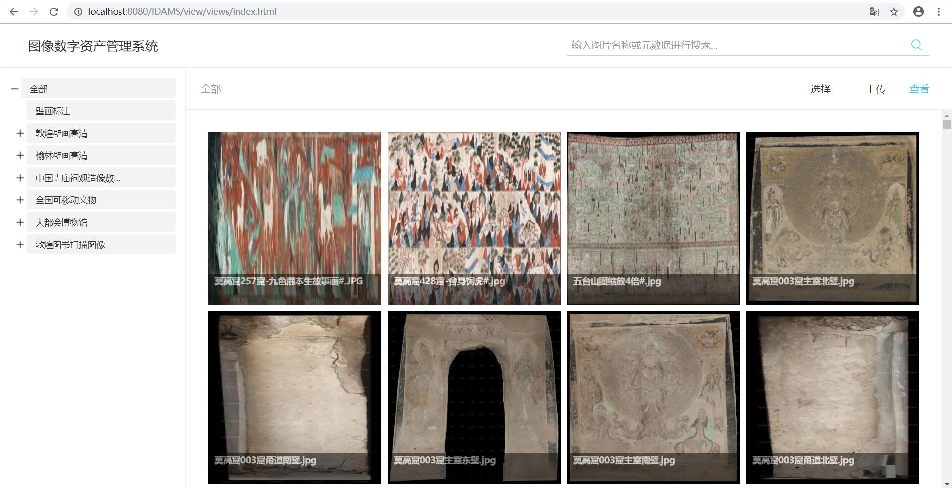
3.数据管理—图像管理系统 Data Management—IDAMS
图像数字资产管理系统用于图像管理、检索与加工
IDAMS is used for image management & retrieval & information organization
图像数字资产管理系统可以按照层级进行图像上传、浏览与元数据管理，并支持按名称或元数据进行检索。系统能够进行图像标注与资料维护。
IDAMS could perform image uploading, browsing and metadata management by layers. All images can be retrieved by name or metadata. The system also supports image annotation and resources maintaining.
图像数字资产管理系统 Image Data Assets Management System
12

Slide 13
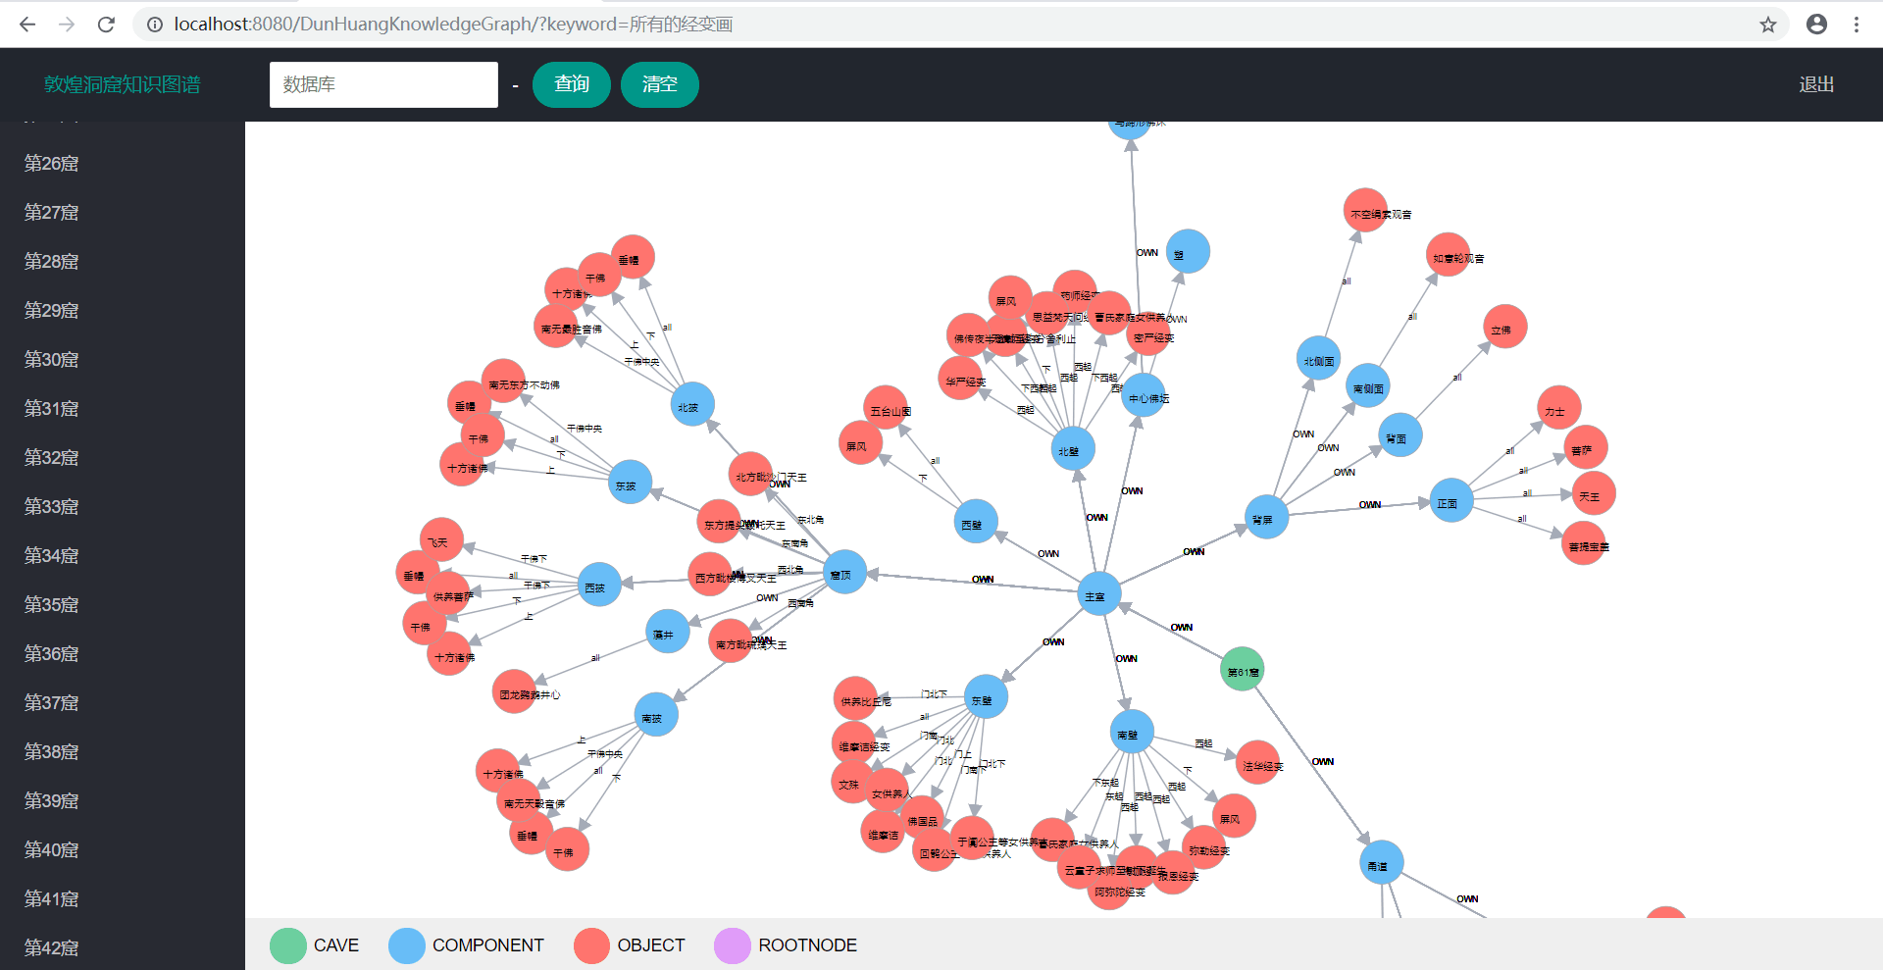
3.数据管理—石窟知识图谱 Data Management—KG for Dunhuang caves
构建了石窟知识图谱 Construct the Knowledge Graph for Dunhuang caves
通过neo4j图数据库，对敦煌石窟内容总录的标注数据进行了结构化存储。构建了石窟知识图谱，并开发了展示系统进行数据可视化。
Using the graph database-neo4j for structured storage of annotation information from Dunhuang caves content list. Then, we construct the knowledge graph for Dunhuang caves, and developed the visualization presentation system to present it.
石窟知识图谱展示系统 Visualization presentation system for KG
13

Slide 14
04
数据集成展示
PART FOUR
Data Integrated Presentation

Slide 15
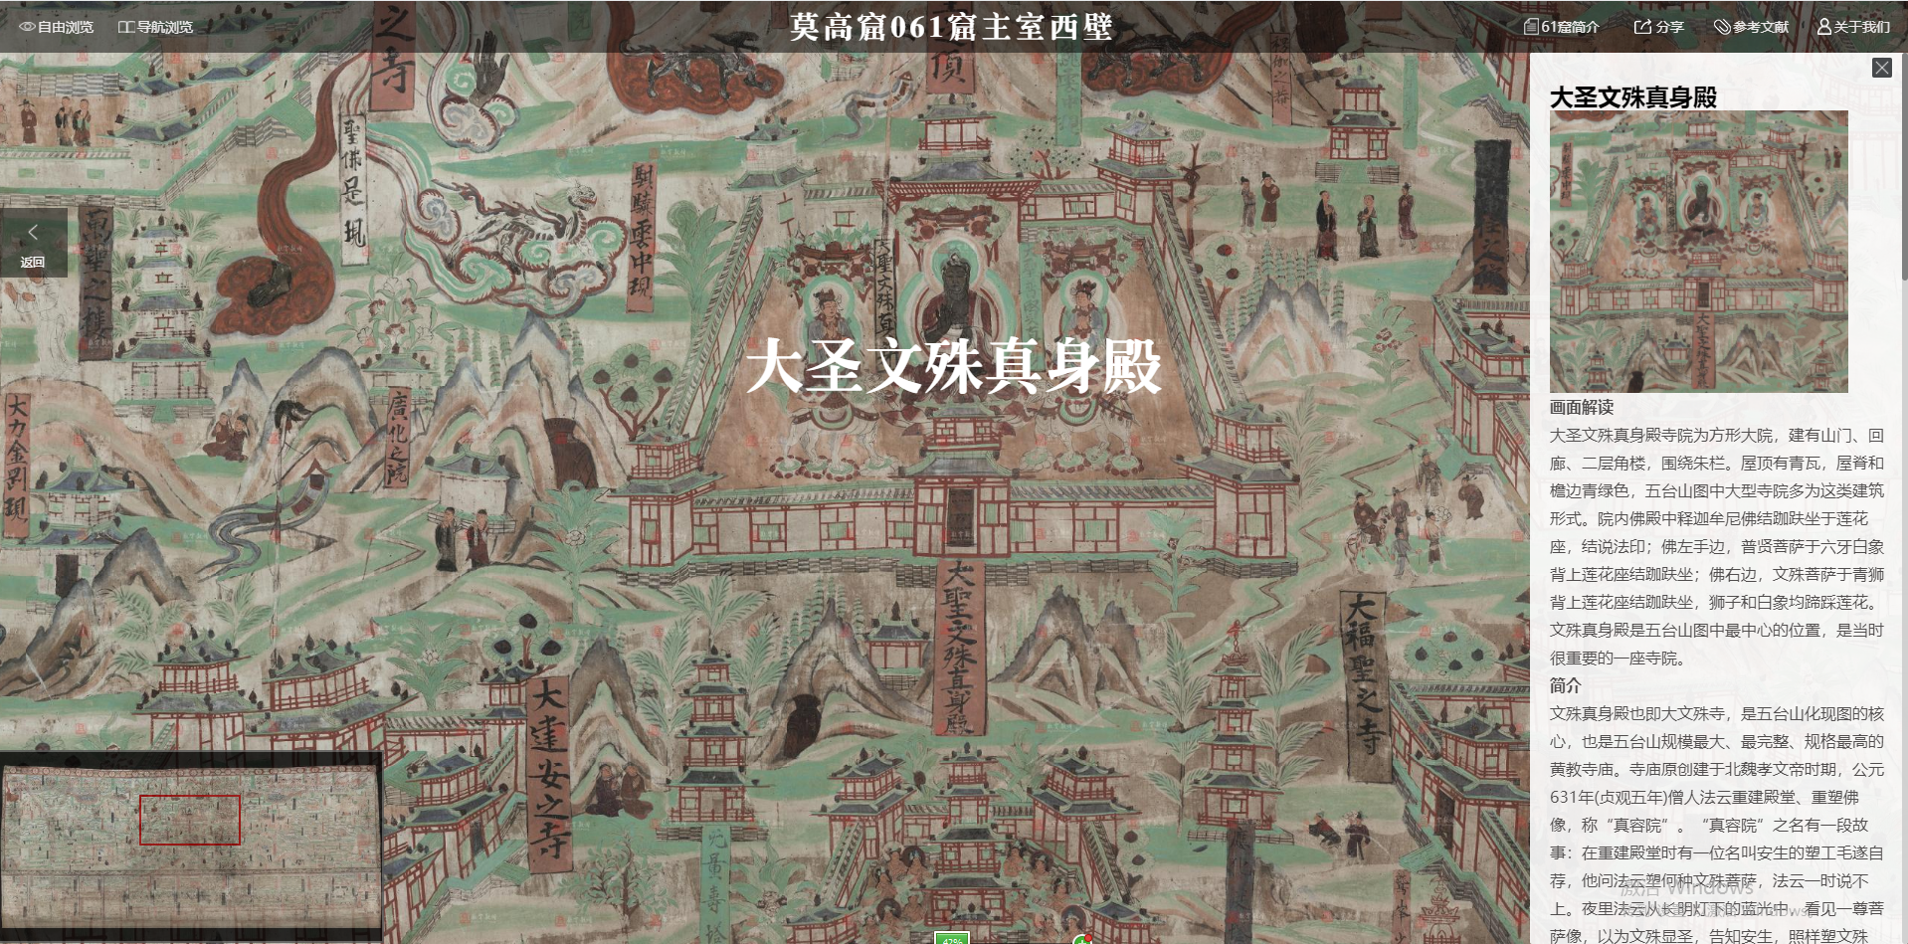
4.数据集成展示 Data Integrated Presentation
设计了集成展示系统，进行了智慧数据集成展示
Designed the Integrated Presentation System to present Smart Data systematically
以内容总录、大辞典与研究文献为基础，对61窟西壁的五台山图进行了标注与资料搜集，并按照相关标准组织这些信息，通过系统实现了集成展示
Take the mural of mountain Wutai in No.61 cave for instance, we annotating images and collecting resources based on the content list, dictionary and academic papers. Then, we organizing all information according to relevant standards, and presenting them systematically through the presentation system.
集成展示系统 Integrated Presentation System
15

Slide 16
武汉大学
感谢各位聆听
数字人文研究中心
王晓光教授团队
Thanks for Listening
Center for Digital Humanities, Wuhan University, Team of Prof. Xiaoguang Wang

